Slide 1
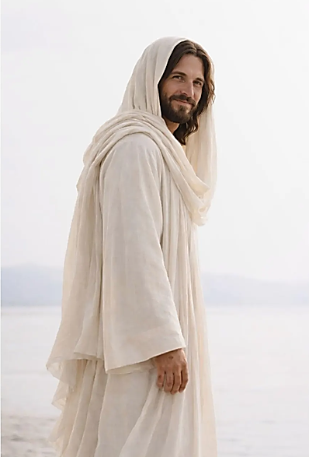
Start with Christ
Nephi 8 - 12

Slide 2
“At the very outset of the Book of Mormon, in its first fully developed allegory, Christ is portrayed as the source of eternal life and joy, the living evidence of divine love...”
Elder Jeffrey R. Holland

Slide 3

1 Nephi 8 – 12 is about:
  Christ’s invitation to partake of God’s love
  Lehi’s dream
  Lehi and Sariah’s family
  Your family and mine
  Nephi’s revelation

Slide 4
Some scholarly interpretations of Lehi’s and Nephi’s visions:
Temple imagery
Garden of Eden and the Fall
Abrahamic covenant
The 23rd Psalm
Mankind’s spiritual progression
Etc.

Slide 5
1 Nephi 8 – 12 offer endless opportunities for learning , discussion, and inspiration .

Slide 6
However, today we will focus on Lehi’s dream and what it can mean in our lives.
That necessarily leaves out much of interest and importance.

Slide 7
Since this is not your first or last reading and learning about Lehi's dream, you bring a wealth of spiritual insight to today’s discussion.

Slide 8
In addition, our other instructors will expand our knowledge of Lehi’s dream and Nephi’s vision.

Slide 9
An overview of Lehi’s dream and Nephi’s vision:

Slide 10
Lehi is shown:
    A dark and dreary wilderness
    The tree with white fruit
    A river of filthy water
    A rod of iron
    A strait and narrow path
    A mist of darkness
    A great and spacious building

Slide 11
Nephi is shown:
    A guiding spirit
    The tree and its meaning
    Christ’s birth, baptism, and ministry
    The covenant path
    Spiritual opposition
    The scattering of Israel
    Pride and worldly wisdom
    The restoration of the Gospel

Slide 12
Lehi sees the journey of individuals toward the tree, while Nephi sees the larger story of Christ, Israel, the Restoration, and the struggle between God's kingdom and the world.

Slide 13
Nephi's vision turns Lehi's symbolic dream into a vision of Jesus Christ and the history of God's work among His children.

Slide 14
Nephi's vision doesn't replace Lehi's vision
—it explains and greatly expands it.

Slide 15
As you know, Lehi’s dream shows his concern for his family’s spiritual welfare.

Slide 16
What can we learn from Lehi’s dream about our own and our loved ones’ spiritual welfare?

Slide 17
1 A dark and dreary waste
1 Dark and dreary waste
Church video of Lehi’s Dream of the Tree of Life
https://youtu.be/IBRiC1slfTw?si=JAumjtaVcaYHF6Hv

Slide 18
A dark and dreary waste;
a prayer for deliverance
“And after I had traveled for the space of many hours in darkness, I began to pray unto the Lord that he would have mercy on me, according to the multitude of his tender mercies.”
1 Nephi 8:8

Slide 19
Has the Lord’s mercy delivered you from a dark and dreary place?
How have God’s “tender mercies” comforted you in dark times?
Have you been blessed by your experience in a “dark and dreary waste”?

Slide 20

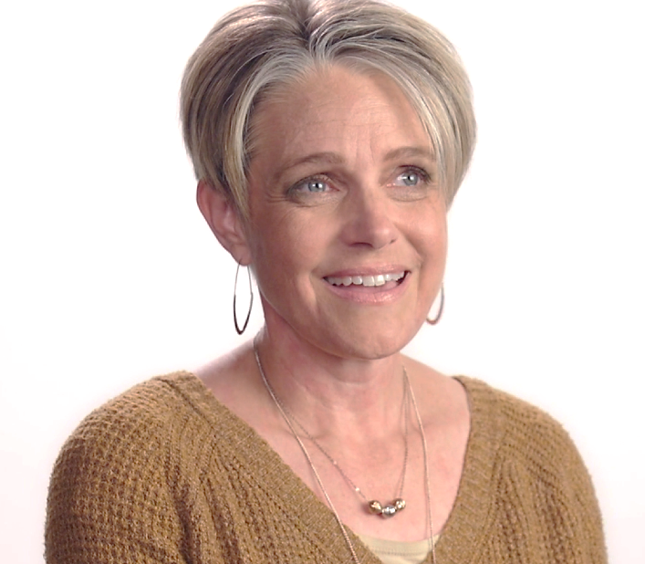
Finding the Savior
https://www.churchofjesuschrist.org/media/video/2023-08-0020-kimberly-finding-the-savior?lang=eng

Slide 21
Has the Lord’s mercy delivered you from a dark and dreary place?
Have you been blessed by your experience in a “dark and dreary waste”?
How have God’s “tender mercies” comforted you in dark times?

Slide 22
“And it came to pass that I beheld a tree, whose fruit was desirable to make one happy. And it came to pass that I did go forth and partake of the fruit thereof; and I beheld that it was most sweet, above all that I ever before tasted.”

Slide 23
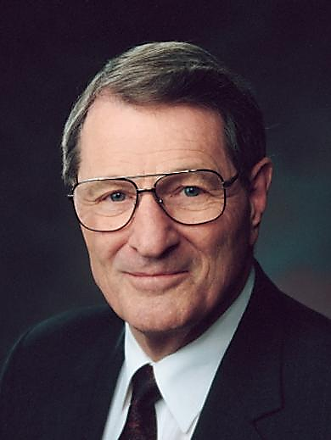
“The Tree of Life:
the Love of God”
Elder Neal A. Maxwell
October 1999

Slide 24
Elder Neal A. Maxwell “The Tree of Life: the Love of God”
https://www.churchofjesuschrist.org/study/video/book-of-mormon-visual-resources/2012-08-1100-the-tree-of-life-as-a-symbol-of-jesus-christ-and-his-atonement?lang=eng

Slide 25

“To partake of the love of God is to partake of Jesus’s atonement and the emancipation and joys which it can bring.”

Slide 26
How have you experienced tasting the fruit, the love of God?

Slide 27
“...wherefore, I began to be desirous that my family should partake of it also; for I knew that it was desirable above all other fruit.” (12)
What advice would you give young parents about how best to invite their children to “partake of the fruit”?

Slide 28
“And it came to pass that I was desirous that Laman and Lemuel should come and partake of the fruit also...but they would not come unto me and partake of the fruit.”
How have you dealt with the heartache when a loved one rejected “the Love of God”?

Slide 29

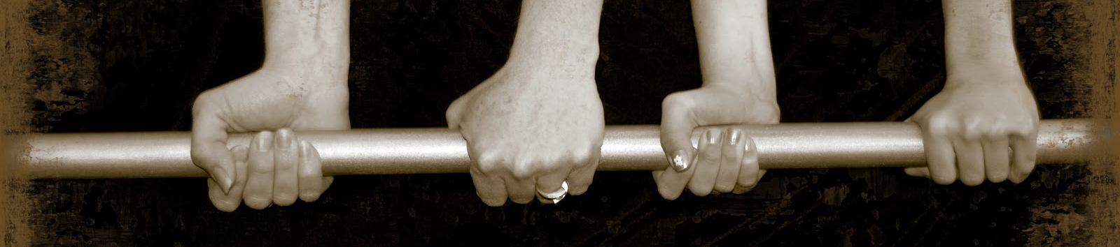
Time for a rest song “The Iron Rod”
Please join together to sing “The Iron Rod”.
The lyrics are on the screen.
We will sing the four verses without the chorus.
We sing the chorus after the fourth verse.

Slide 30
The Iron Rod
To Nephi, seer of olden time,
A vision came from God
Wherein the holy word sublime
Was shown an iron rod.

Slide 31
While on our journey here below,
Beneath temptation’s pow’r
Through mists of darkness we must go,
In peril ev’ry hour.

Slide 32
And when temptation’s pow’r is nigh,
Our pathway clouded o’er,
Upon the rod we can rely,
And heaven’s aid implore.

Slide 33
And, hand o’er hand, the rod along,
Through each succeeding day,
With earnest prayer and hopeful song,
We’ll still pursue our way.

Slide 34
CHORUS
Hold to the rod, the iron rod;
‘Tis strong, and bright, and true.
The iron rod is the word of God;
‘Twill safely guide us through.

Slide 35
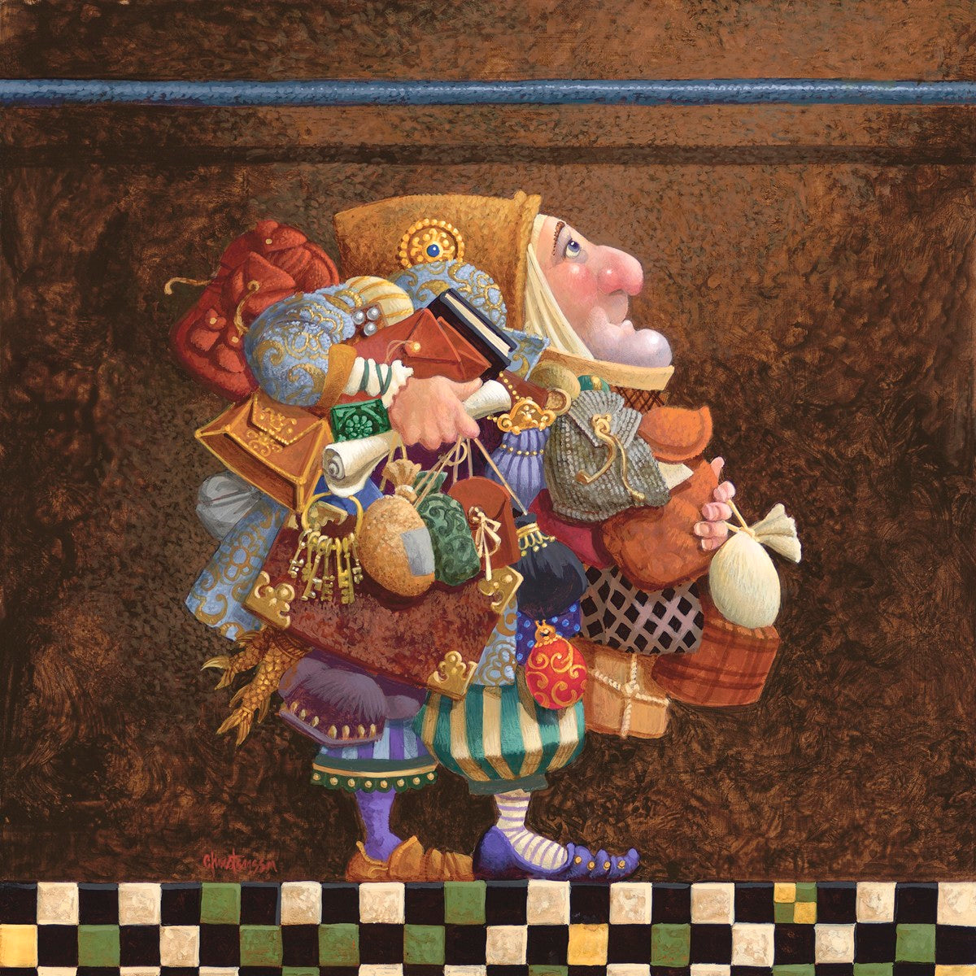
OOPS!
Hold To The Rod, The Iron Rod
James Christensen

Slide 36
“And it came to pass that there arose a mist of darkness; yea, even an exceedingly great mist of darkness, insomuch that they who had commenced in the path did lose their way, that they wandered off and were lost.”

Slide 37
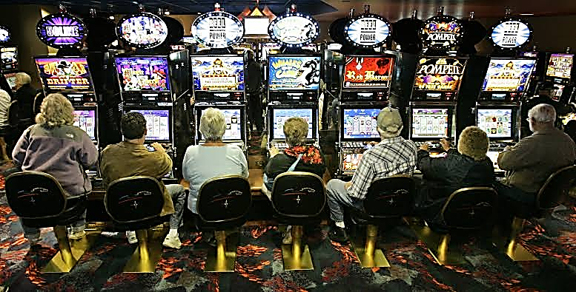
My husband’s idea of a mist of darkness

Slide 38

What present-day mists of darkness lead some “who had commenced in the path” to “lose their way”?

Slide 39
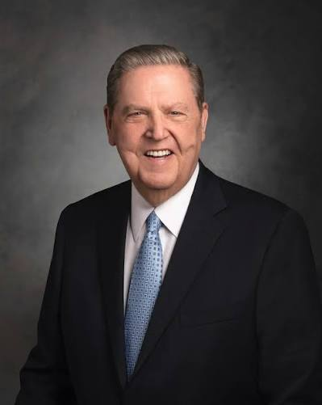
Elder Jeffrey R. Holland “Mists of darkness”

Slide 40
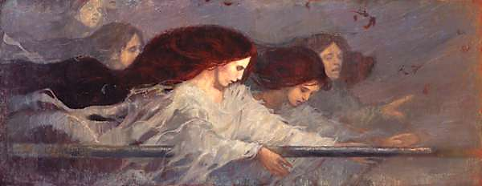
Lehi “saw other multitudes pressing forward; and they came and caught hold of the end of the rod of iron; …continually holding fast to the rod of iron, until they came forth and fell down and partook of the fruit of the tree”.

Slide 41
These are they who persevere and hold fast to the Word of God.
Describe the life of someone you know who “holds fast to the Word of God”.

Slide 42
4 Many drown, many wander in strange roads, mocking crowds, “…but we heeded them not.”

Slide 43
“And great was the multitude that did enter into that strange building. And after they did enter into that building they did point the finger of scorn at me and those that were partaking of the fruit also; but we heeded them not.”

Slide 44
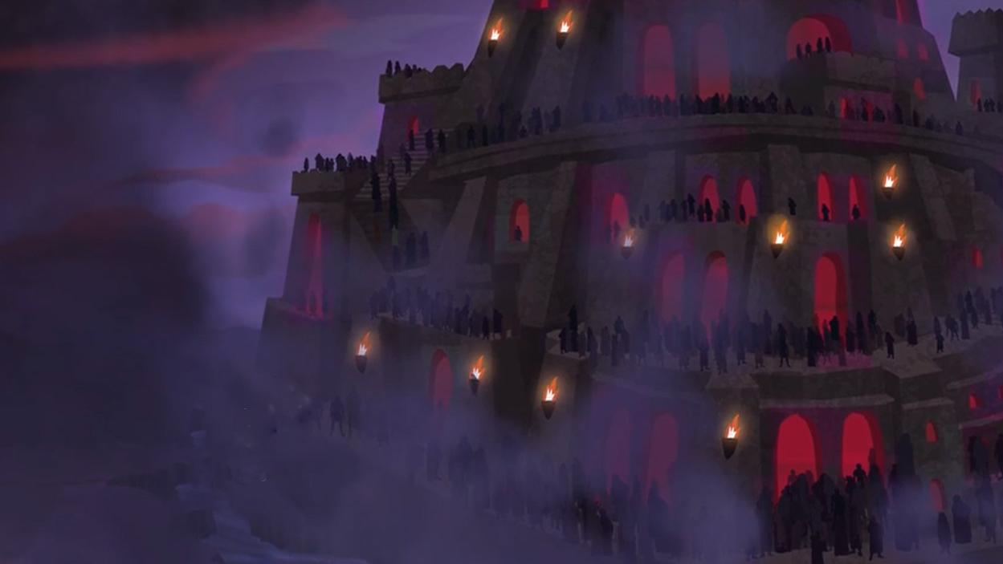
My unexpected encounter with a mocker in the “great and spacious building”:

Slide 45

Paul Theroux
The Happy Isles of Oceania
An unfair and inaccurate description of Latter-day Saint influence in “Oceania”.

Slide 46
“The American Mormons who evangelize on these islands can seem rather fearsome and intrusive, like the worst sort of door-to-door insurance salesmen…with all the answers, clutching copies of the book that the Angel Moroni gave…to Joseph Smith…

Slide 47
“…Smith put “peepstones” on his eyes and
a blanket over his head…dictating the text
to Emma, the first of his fifty wives.
(‘When I see a pretty woman, I have to pray.’)” Etc.

Slide 48
“Mormonism was like junk food: It was American to the core, and it looked all right, but it wasn’t until after you had swallowed some that you felt strange.”

Slide 49
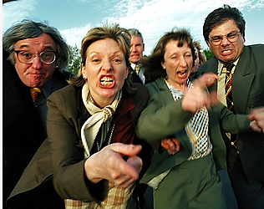
How do you “heed not” those who mock the Church of Jesus Christ, its leaders, and members?

Slide 50
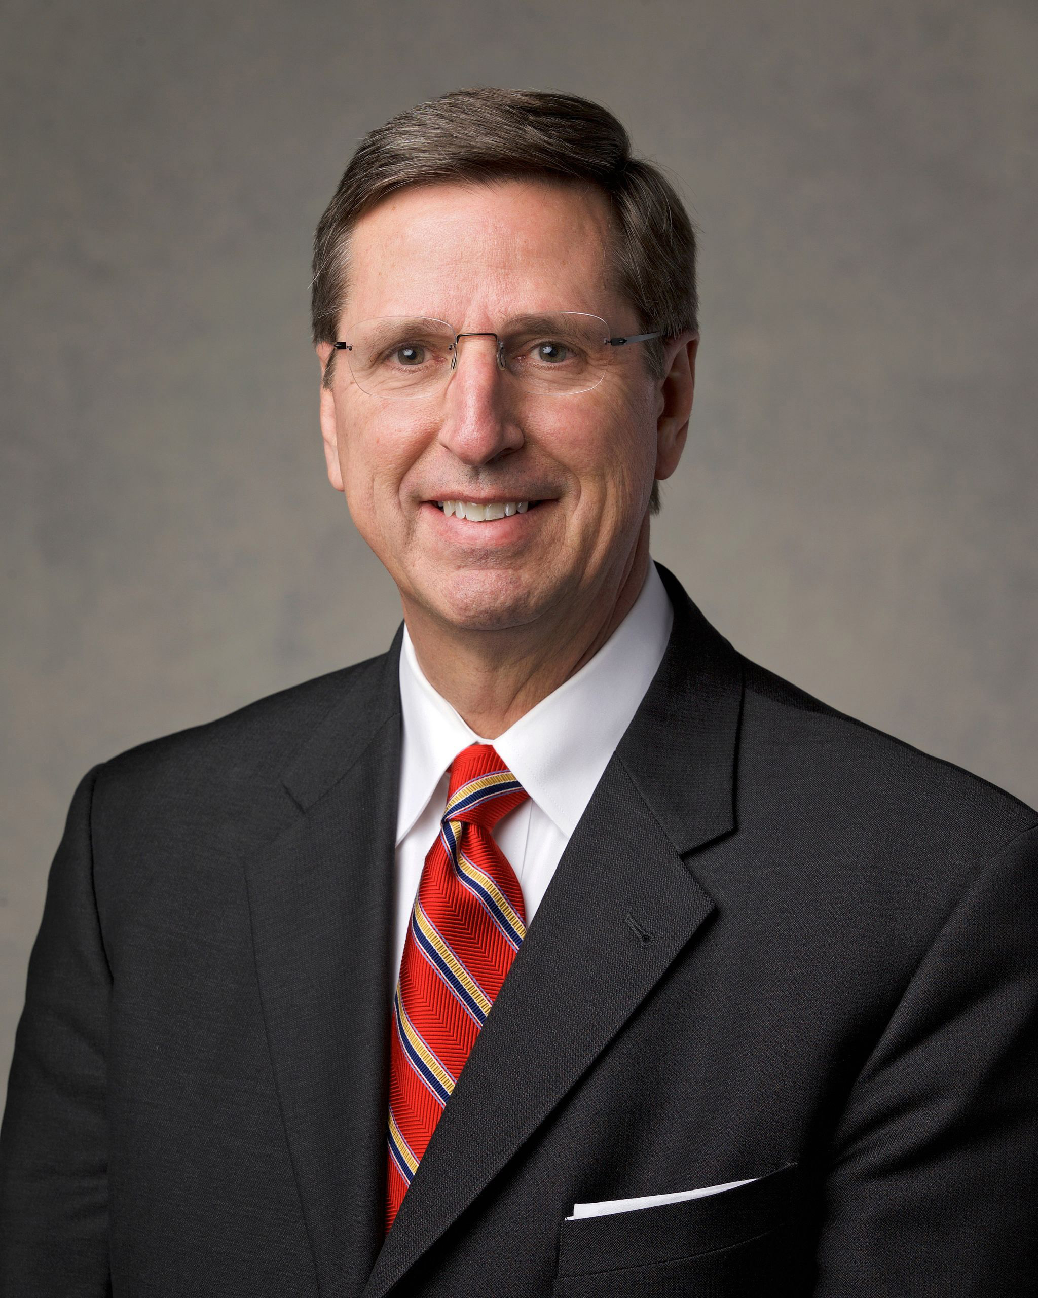
Elder Kevin W. Pearson
“Stay by the Tree”
April 2015

Slide 51
Elder Kevin W. Pearson “Stay by the Tree” April 2015
https://www.churchofjesuschrist.org/media/video/2015-04-5020-elder-kevin-w-pearson?lang=eng

Slide 52
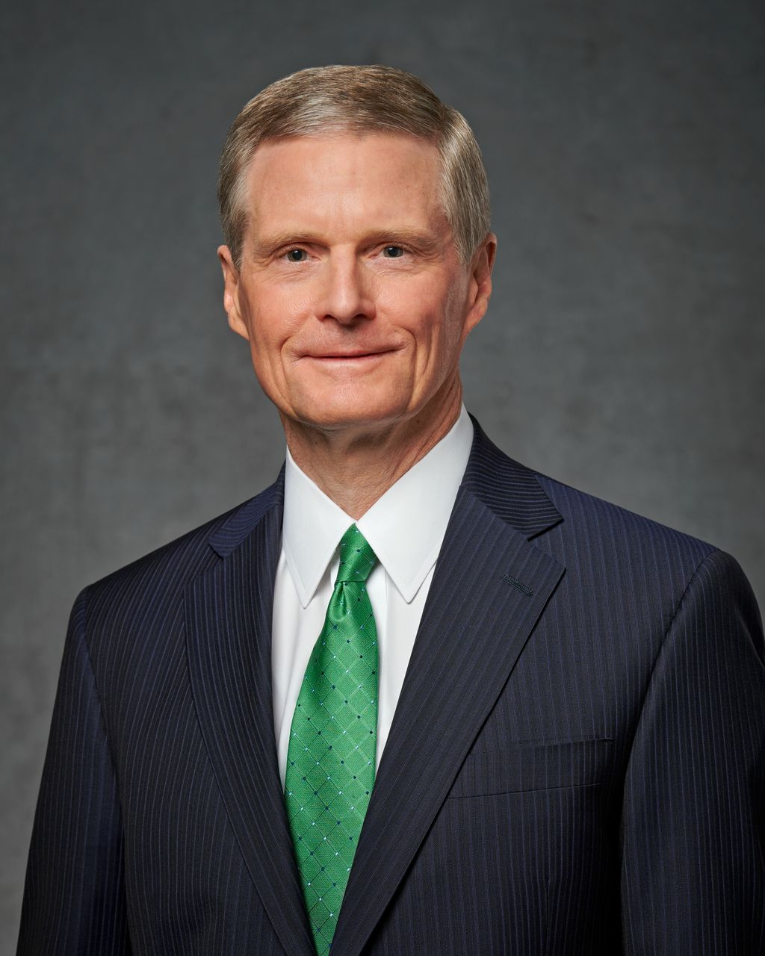
Elder David A. Bednar
“But we heeded them not.”
April 2022

Slide 53
2 Elder Bednar: “But We Heeded Them Not” Testimony
https://www.churchofjesuschrist.org/study/general-conference/2022/04/14bednar?lang=eng

Slide 54
LET US ALL PRESS ON
Let us all press on in the work of the Lord,
That when life is o’er we may gain a reward;
In the fight for right let us wield a sword,
The mighty sword of truth.

Slide 55
We will not retreat, though our numbers may be few
When compared with the opposite host in view;
But an unseen pow’r will aid me and you
In the glorious cause of truth.

Slide 56
If we do what's right we have no need to fear,
For the Lord, our helper, will ever be near;
In the days of trial his Saints he will cheer,
And prosper the cause of truth.

Slide 57
CHORUS
Fear not, though the enemy deride;
Courage, for the Lord is on our side.
We will heed not what the wicked may say,
But the Lord alone we will obey.

Slide 58
5 Final plea to Laman and Lemuel

Slide 59
“And he did exhort them then with all the feeling of
a tender parent, that they would hearken to his words;...he bade them to keep the commandments of the Lord.”
          Sariah’s tears
          Laman’s not understanding
          Heartache all around

Slide 60
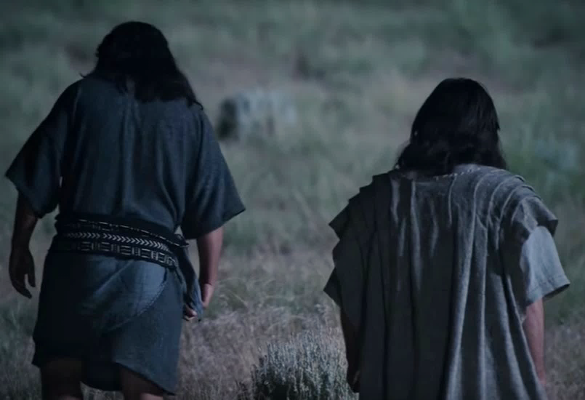
The Book of Mormon can be called a tragedy,

Slide 61
a tragedy of lost families,

Slide 62
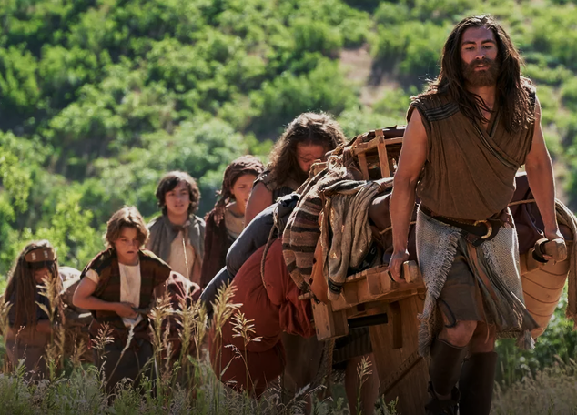
a tragedy of lost generations,

Slide 63
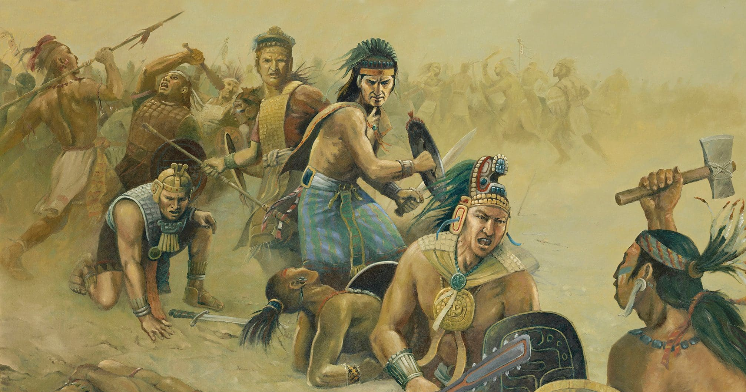
a tragedy of lost civilizations,

Slide 64
However, it is not ultimately a tragedy. The Book of Mormon is a promise of great hope through the birth, life, sacrifice, atonement, and resurrection of our Savior.
_____

